Slide 1
Introduction to Academic Writing
Notes:
This is Academic Writing in English. It may be different from Academic Writing in other languages. Quite high-level English is assumed.

Slide 2
???
???
???
Notes:
Three questions that we must always ask ourselves when we write

Slide 3
WHY?
Why am I writing?
What is my purpose?
What is my message?
???
???

Slide 4
WHY?
Why am I writing?
What is my purpose?
What is my message?
WHO?
Who is my reader?
???

Slide 5
WHY?
Why am I writing?
What is my purpose?
What is my message?
Academic
Style
WHO?
Who is my reader?
HOW?
How do I organize and shape my writing?

Slide 6

Features of Academic Style
Notes:
There is no justification for informality in academic writing, especially in the sciences.

Slide 7
Features of Academic Style
Precision
Explicitness
Clarity
Caution
Concision
Distance
Objectivity
Conventions
Vocabulary
&
Grammar
Notes:
put in groups, have them discuss how each of these might manifest in academic writing Precision: “lots of things can make someone sad” – “clinical depression is known to have many potential causes”
Explicitness: “lots of people are saying” – who? “The experiment failed. There was human error.” – The experiment failed because of human error.
Clarity: “We used methods used by others” – “We used the standard sampling method first introduced by Strange and Houser in 1989…” Caution: “This is clearly the cause of the disease.” – “The evidence very strongly suggests that this is a potential cause of the disease.”
Concision: “In the not too distant future, the human population of the Earth will likely find themselves struggling to adjust to circumstances that they never could have predicted.” Distance: “According to everyone, dogs are always cute” Objectivity: “The ridiculous idea that the 1969 moon landing was staged is the best example of a conspiracy theory.”
Conventions: No contractions, passive, structure, etc.

Slide 8

Academic Vocabulary
Field Specific Academic English
Academic English
single word verbs, Latin roots
General English
phrasal verbs, Germanic/English roots

Slide 9
Practice 1.1 - General, Academic, and Specific
concern
committee
clothe
concept
corticosteroids
camber
constructivism
character
complete
coefficient
caryatid
create
coincide
confer
circumstantial
curia
https://www.newgeneralservicelist.com/
Notes:
Academic: concept, create, coincide, confer; General: concern, committee, clothe, character, complete S: corticosteroids, camber, constructivism, coefficient, caryatid, circumstantial, curia

Slide 10
Grammatical Features of Academic English
Precision
Explicitness
Clarity
Caution
Concision
Distance
Objectivity
Conventions
Passive Voice
Multi-clause / compound & complex sentences
Modal Verbs
Language Markers (Cause/Effect, Sequence, etc.)

Slide 11
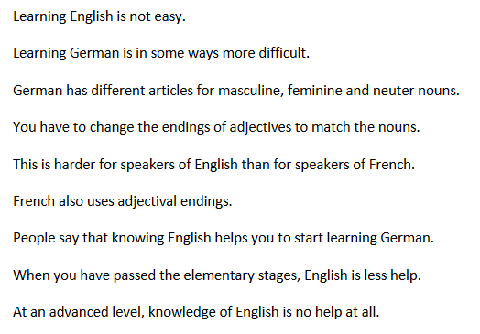
Practice 1.2 - Creating an Academic Style Text
Rewrite the information provided as TWO or THREE sentences that reflect ACADEMIC STYLE. That involves deciding how the ideas are logically related, using appropriate language markers to indicate those relationships, and rewriting the sentences to show academic vocabulary and grammar.

Slide 12
Practice 1.2 - One Possible Solution
Learning English is often difficult, but in a number of ways learning German is more difficult, as German uses different articles for masculine, feminine and neuter nouns. Moreover, German requires speakers to change the endings of its adjectives, which is harder for speakers of English than for, say, speakers of French, which also uses adjectival endings. It is often said that knowing English can facilitate the learning of German, but once a student has passed the basic stages, it is significantly less helpful; moreover, knowledge of English is essentially of no help at all at the advanced level.

Slide 13
Practice 1.3 - Rewriting for Formality
The investigation has been going for four years. How good has it been? At this stage, researchers can’t tell, because they still need to check out the data to account for differences in age, gender, socio-economic-status, etc. Once that work is done though, the information will be really first-class.
Rewrite the paragraph provided to make it align with academic style, especially in terms of formality.

Slide 14
Practice 1.3 - One Possible Solution
The investigation has been going for four years. How good has it been? At this stage, researchers can’t tell, because they still need to check out the data to account for differences in age, gender, socio-economic-status, etc. Once that work is done though, the information will be really first-class.
The investigation has been underway for four years. Researchers cannot yet determine the effectiveness of the project because it is necessary to first analyse the data to control for age, gender, socio-economic status and other demographic variables. Despite this, the information collected is expected to be highly valuable for future studies.

